Slide 1
City of Raleigh
Department of Transportation
Neighborhood Traffic Management Program (NTMP)
Traffic Calming 101

Slide 2
Agenda
Neighborhood Traffic Management Program (NTMP)
Traffic Calming Overview
Traffic Calming Process & Project Eligibility
Traffic Calming Treatments
Project Areas
Questions & Contact Information

Slide 3
Traffic Calming Overview
What is traffic calming?
Combination of measures that reduce the negative effects of motor vehicle use, alter driver behavior, and improve conditions for non-motorized street users (USDOT)
What is Raleigh’s response to address the traffic calming need?
The City of Raleigh adopted the Neighborhood Traffic Management Program (NTMP) and gave it three tools
Multiway Stop Conversions – specifically used for intersection safety
Speed Limit Reductions – to better set more appropriate speed limits in residential settings
Traffic Calming Projects – to encourage speed compliant behavior when signage is not enough
What is the vision of the NTMP?
To improve safety, improve speed compliance, and enhance the quality of life along residential streets in Raleigh’s neighborhoods

Slide 4
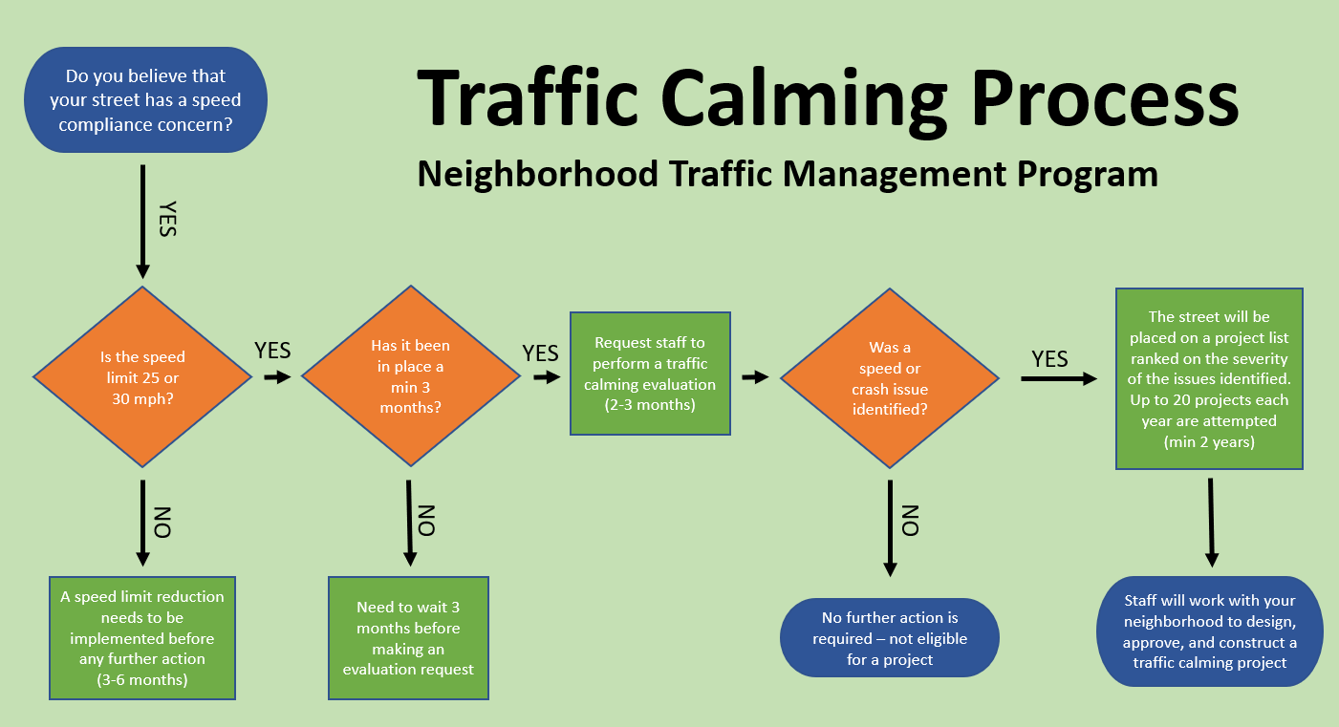
Traffic Calming Process

Slide 5
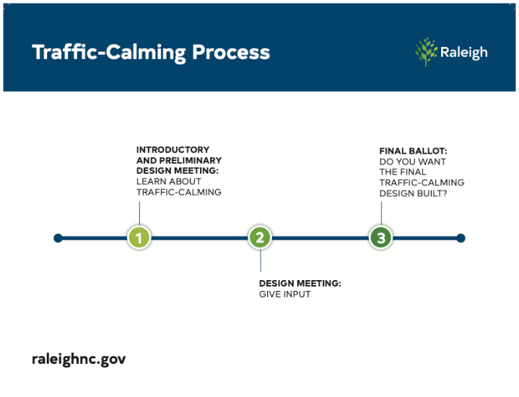
Traffic Calming Project Process
Step 1
Teach about Traffic Calming as a concept
Present staff’s best practice layout/design
Paint layout on street to help visualize project footprint
Receive resident design feedback
Answer resident Questions
Step 2
Present updated layout/design based on feedback
Receive resident design feedback
Answer resident Questions
Step 3
Ballot Neighborhood asking “Do you want this Project Constructed?”
On-street: 70% approval rating
Neighborhood: 60% approval rating

Slide 6
Traffic Calming Treatment Selection
Why are certain treatments used on one street and not the other?
Traffic calming projects work to stay 100% within the existing street footprint. For that reason, existing street widths are a major factor in device selection
Streets that are < 31’ wide can only support vertical treatment options. The street is not wide enough to allow for effective horizontal measures
Streets that are > 31’ wide can support both vertical and horizontal traffic calming treatments options and staff works to propose the best treatment for each unique situation
Proximity to Fire Stations and designated emergency routes are subject to additional restrictions on treatment choice and potentially result in a street being not eligible for any traffic calming project
What is the design process?
The design and treatment choice is heavily influenced by neighborhood feedback and suggestions. If a certain device is approvable from an engineering perspective and generally desired by the neighborhood, it is incorporated into the design

Slide 7
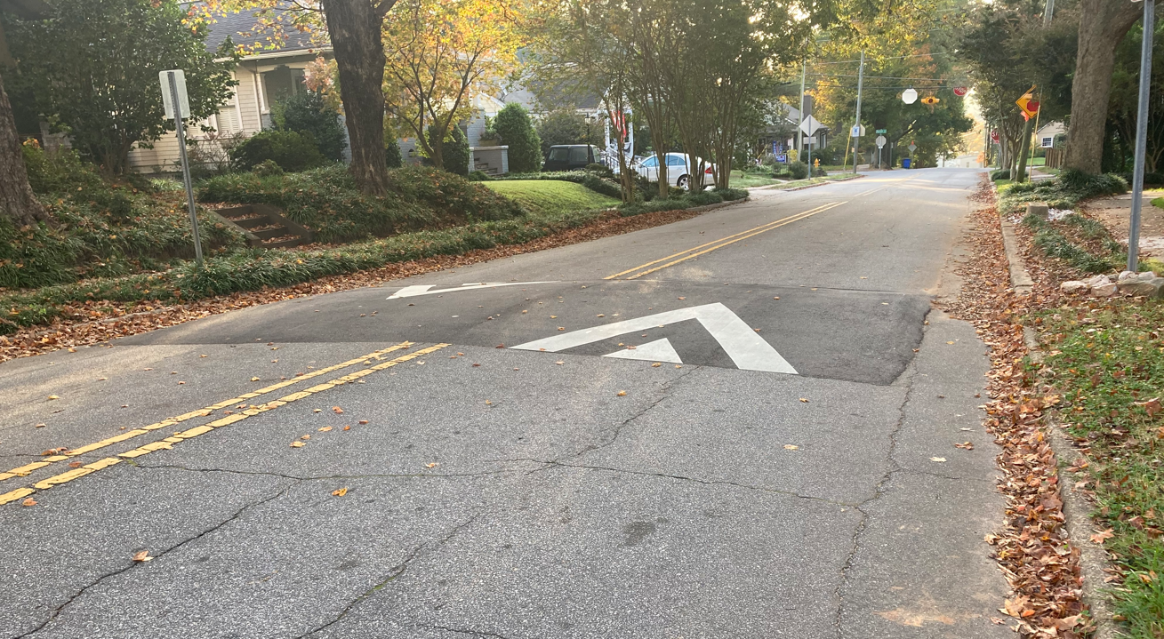
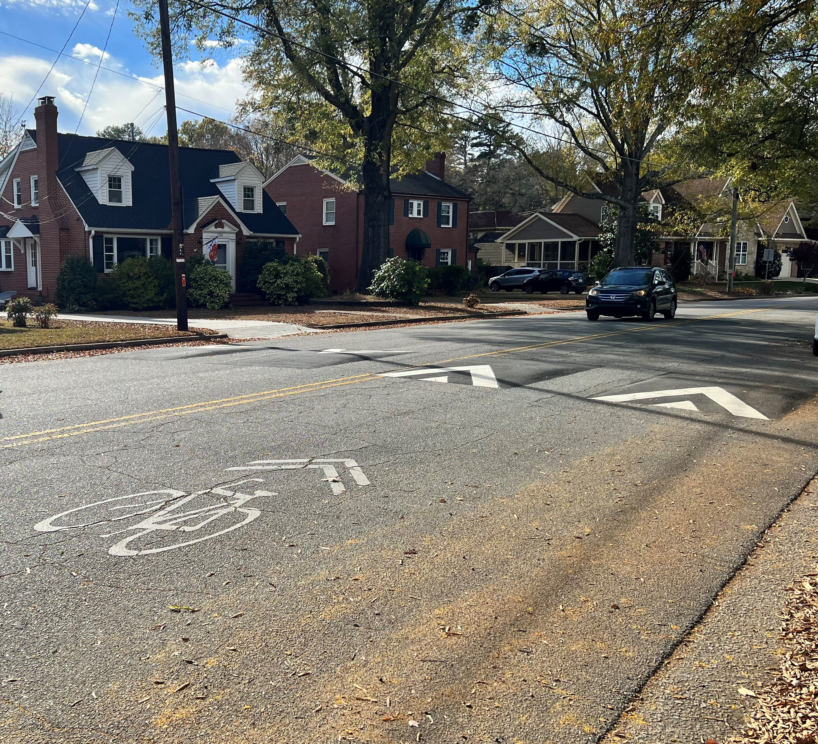
Traffic Calming Treatments
Vertical Treatment Types
Speed Cushion
Speed Table
Speed Humps

Slide 8
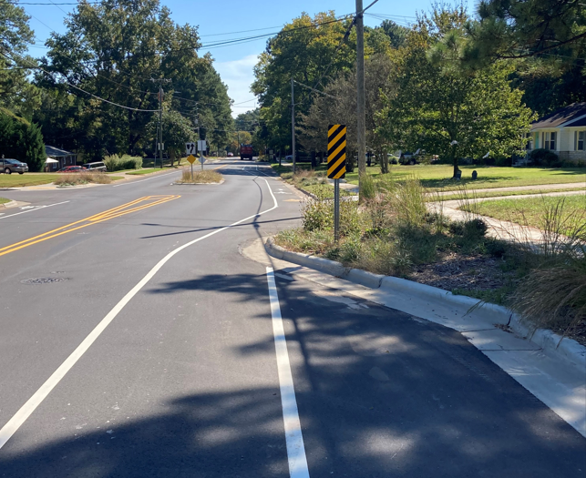
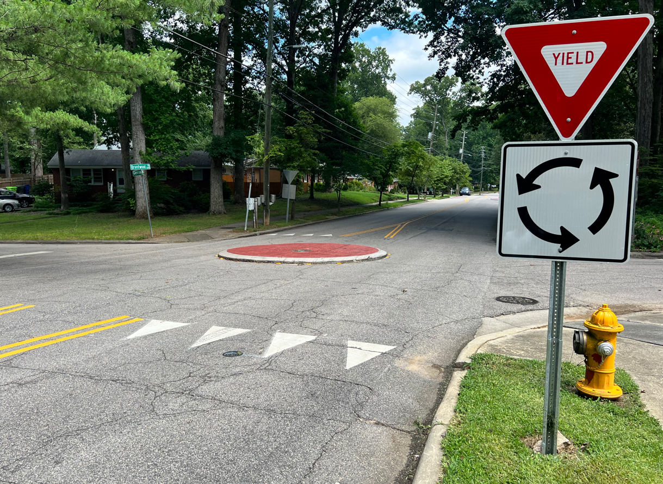
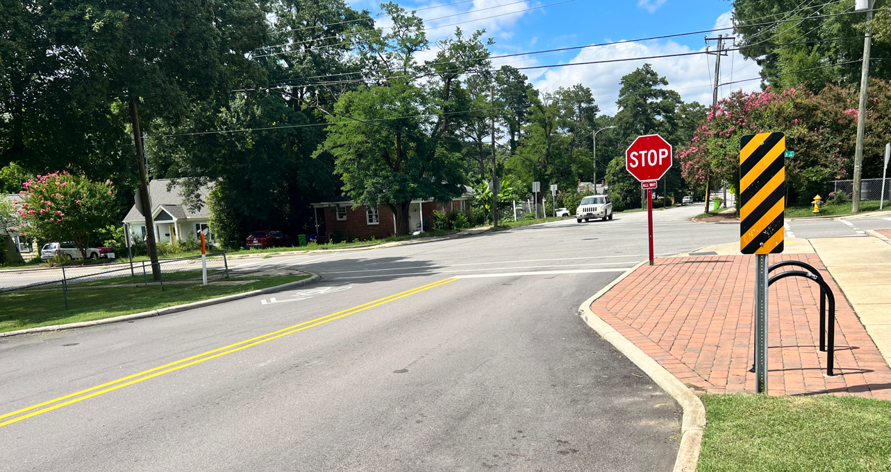
Traffic Calming Treatments
Horizontal Treatment Types
Curb Bump Out
Neighborhood Traffic Circle
Chicane

Slide 9
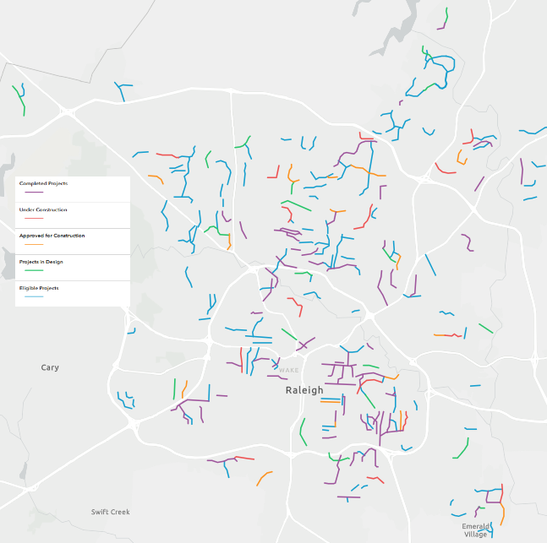
Raleigh Traffic Calming Projects
Completed Projects - 68
Average Speed Diff: -8.78 mph
Average After 85th% Speed vs Speed Limit: +.21 mph
Average Volume Diff: -576.57 vehicles per day
Average Change in Vol: -24.56%
Average Change in Crashes: -74.17%
Projects in Construction - 15
Approved for Construction - 17
17 expected construction: 2025
Projects in Engagement/Design - 20
Neighborhood Vote: Oct/Nov 2024
Eligible Future Projects - 118
Goal of up to 20 project offerings each year

Slide 10
Questions?
Contact Information:
NTMP@raleighnc.gov
919-996-4066

