Slide 1
TRANSPORTATION
Preliminary Traffic Calming Design & Public Comment

Slide 2
How do we approach the traffic calming design?
Consistent treatment placement along entire street
  400’ – 700’ spacing of treatments
  Close spacing is used for streets with a higher speed compliance issue
  Target pedestrian heavy amenities to increase safety, such as neighborhood park and the adjacent Neuse River greenway trail
Targeted placement to fix a speed related crash issue
  If a pattern of speed related crashes is identified, targeted treatment placement can eliminate that crash pattern
  If no pattern is identified locationally, but multiple speed related crashes have occurred, consistent treatment spacing can help eliminate crashes along an entire street

Slide 3
Treatment Limitations
Your street’s width will determine what types of treatments can be placed
  Mackinac Island Ln is approximately 36’ wide
  Based on this street width, horizontal and vertical traffic calming elements are appropriate and are being proposed as part of this project

Slide 4
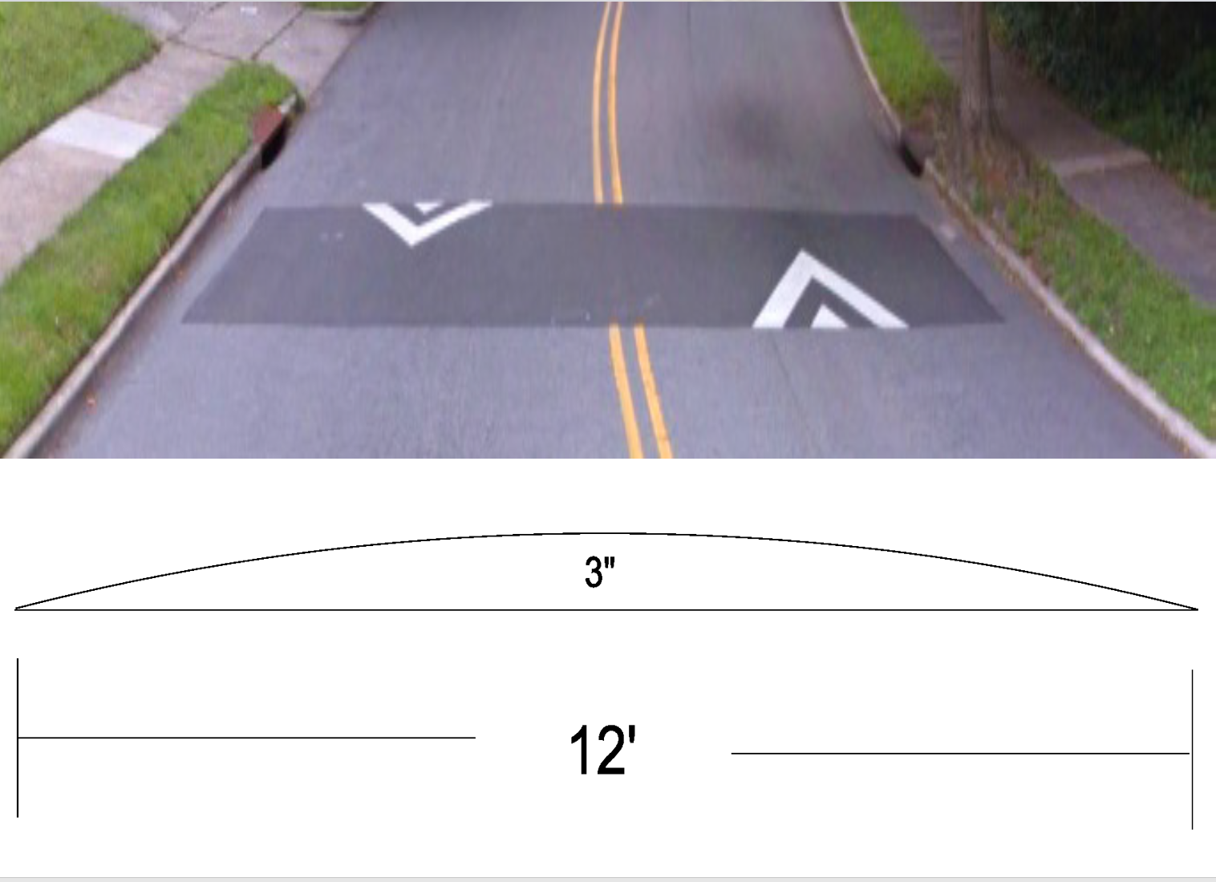
Speed Humps
(vertical)

Slide 5
Speed Humps
(vertical)
Pros
Cons
Can be the most effective
Fast installation time/Less impact during construction
Versatile placement options based on compact footprint
Does not contrast as much with existing roadway
Impact to driving comfort
Creates slight delay in emergency service’s response times

Slide 6
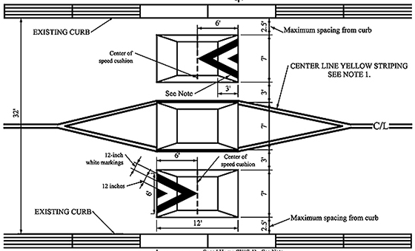
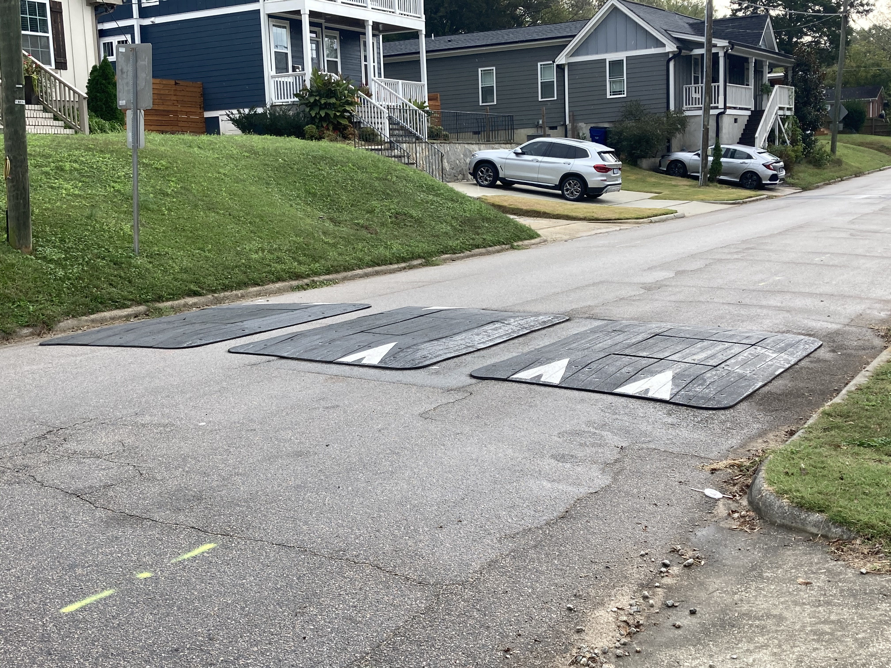
Speed Cushions
(vertical)
*Speed Cushion dimensions vary based on roadway dimensions

Slide 7
Speed Cushions
(vertical)
Pros
Cons
Can be as effective as speed humps
Relatively low impact installation timeline, but slightly slower than a standard hump as more labor is required
Versatile placement options based on compact footprint
Slightly faster emergency service’s response times due to tire slits for larger vehicles
Does not contrast as much with existing roadway
Reduced driving comfort
There is still some level of delay to emergency service’s response times when compared with no treatment

Slide 8
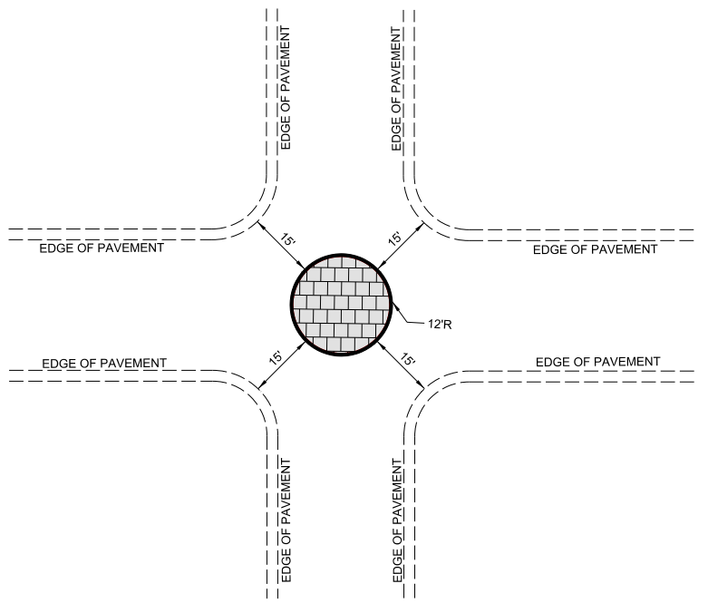
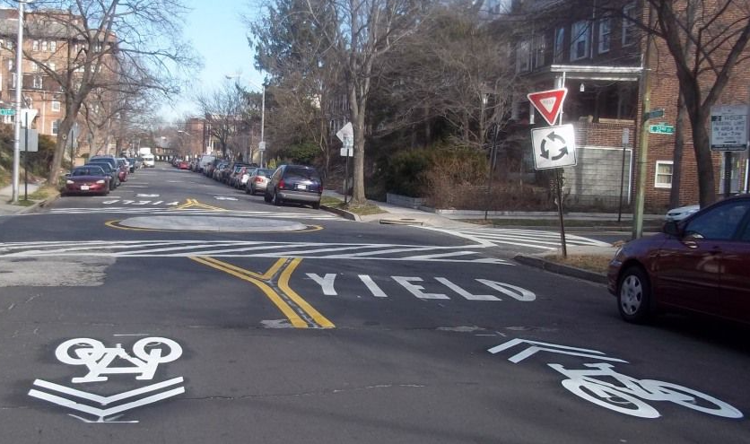
Neighborhood Traffic Circle
(horizontal)
*Neighborhood Traffic Circle to be placed within existing curb lines – no impacts outside of existing roadway

Slide 9
Neighborhood Traffic Circle
(horizontal)
Pros
Cons
Helps decrease speed of vehicles as they enter/drive through the intersection
Helps to reduce the frequency and severity of collisions
Increases safety for pedestrians and cyclists at the intersection
Minimal impact to emergency service’s response times
Not all intersections meet the minimum dimensions for installation
Slightly longer installation time, typical for treatments made of concrete

Slide 10
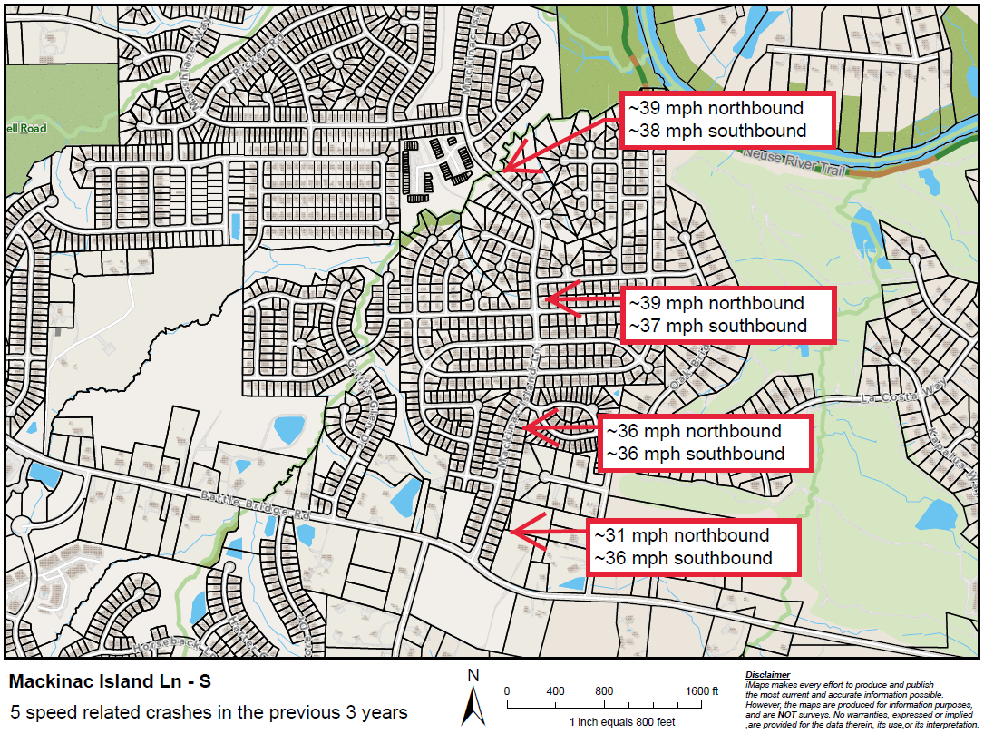
Evaluation Data

Slide 11
Design Process
Based on the speed progression along Mackinac Island Ln, we are proposing treatment spacing of approximately 400’ – 500’ intervals
Speed related crashes are relatively evenly spread along this stretch of Mackinac Island Ln. Focusing on speed reduction will work to achieve speed compliance and also help eliminate the speed related crashes that have occurred

Slide 12
Project Goal
The project will be deemed effective if 85% of drivers are going at or below the 25 mph speed limit and top driver speed is capped at around 5-7 mph over the speed limit
  Based on your location, Southgate Dr and Dandridge Dr are the closest completed traffic calming project to you with this style of completed project. We encourage you to go drive these streets yourself to experience the final project.
Once the project has been completed for approximately 6 months, an after-study will be performed to measure project effectiveness

Slide 13
Public Comment
What are your thoughts on the proposed design?
  Should we place more or less treatments along the street?
Have we adequately addressed problem areas you see?
  Should we place another traffic calming treatment in a targeted location?
What are your thoughts on the mix of treatments being proposed?
  Please review our video about Neighborhood Traffic Circles that may answer some immediate questions.
What other questions, comments, suggestions do you have?

Slide 14
Please direct all comments and questions to staff using the PublicInput portal for Mackinac Island Ln - S. Staff will respond and we can have a neighborhood wide conversation.

