Slide 1
TRANSPORTATION
Final Traffic Calming Design & Public Comment

Slide 2
Project Goal
The project will be deemed effective if 85% of drivers are going at or below the 25 mph speed limit and top driver speed is capped at around 5-7 mph over the speed limit
Based on your location, the closest completed projects are on Beverly Dr, Rose Ln, and Grantland Dr. I strongly urge you to drive these streets for yourself to get a better idea of what a completed project will look like.
Once the project has been completed for approximately 6 months, an after-study will be performed to measure project effectiveness

Slide 3
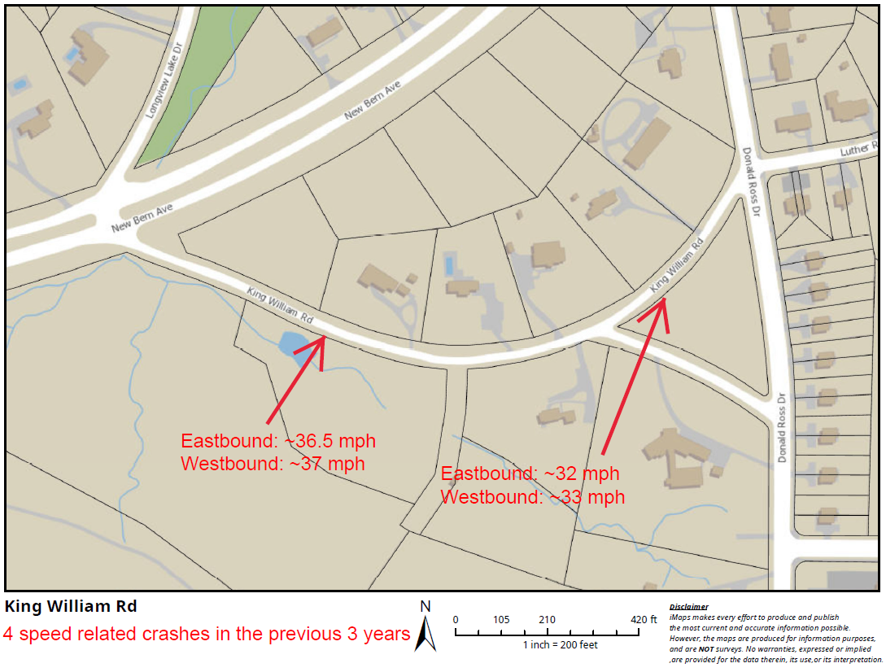
Evaluation Data

Slide 4
Treatment Selection and Spacing
Based on the characteristics of King William Rd, speed humps have been deemed the most appropriate traffic calming treatment.
All traffic calming treatments have been spaced at approximately 500’ per best placing practices.

Slide 5
Speed Humps (vertical)

Slide 6
Speed Humps (vertical)
Pros
Cons
Can be the most effective
Fast installation time/Less impact during construction
Versatile placement options based on compact footprint
Does not contrast as much with existing roadway
Impact to driving comfort
Creates slight delay in emergency service’s response times

Slide 7
Design Comments from the Neighborhood
Requested moving speed hump closer to New Bern Ave.
Staff evaluated shifting per this request, but at this time has deemed the shown location to be a greater positive impact. Spacing between New Bern Ave and the first speed hump is within best practices spacing. Also, the speed hump is near where the houses begin and a driveway into the golf course. A speed hump in this location will have the greatest positive impact to those living along King William Rd.
Requested we look at shoulder quality.
Staff will evaluate and see what improvements can be made during the construction process.

Slide 8
Public Comment
Based on this updated design, what comments do you still have?
Have we adequately addressed problem areas you see?
What other questions, comments, suggestions do you have?

Slide 9
Next Steps
Once the public comment period for the Final Design ends, the neighborhood will be sent a Final Ballot asking if you want the project constructed. Ballot approval thresholds will be the same as the First Ballot.
On-street
Participation Minimum: 50%
Approval Rating Minimum: 70%
Neighborhood
Participation Minimum: 25%
Approval Rating Minimum: 60%

Slide 10
Please direct all comments and questions to staff using the PublicInput portal for King William Rd. Staff will respond and we can have a neighborhood wide conversation.

