Slide 1
TRANSPORTATION
Final Traffic Calming Design & Public Comment

Slide 2
Project Goal
The project will be deemed effective if 85% of drivers are going at or below the 25 mph speed limit and top driver speed is capped at around 5-7 mph over the speed limit
Based on your location, Northbrook Dr, E Rowan St, and Dartmouth Rd are the closest completed traffic calming projects to you. We encourage you to drive these streets for yourself to experience the final project.
Once the project has been completed for approximately 6 months, an after-study will be performed to measure project effectiveness

Slide 3
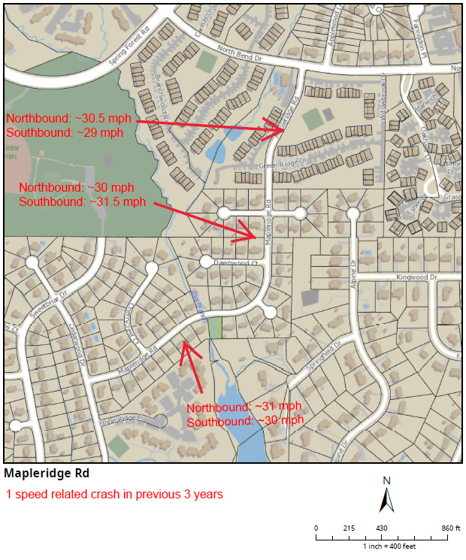
Evaluation Data

Slide 4
Treatment Selection and Spacing
Based on the characteristics of Mapleridge Rd, a mixture of horizontal and vertical traffic calming treatments have been deemed the most appropriate.
All traffic calming treatments have been spaced at approximately 500’ per best placing practices.

Slide 5
Speed Humps (vertical)

Slide 6
Speed Humps (vertical)
Pros
Cons
Can be the most effective
Fast installation time/Less impact during construction
Versatile placement options based on compact footprint
Does not contrast as much with existing roadway
Impact to driving comfort
Creates slight delay in emergency service’s response times

Slide 7
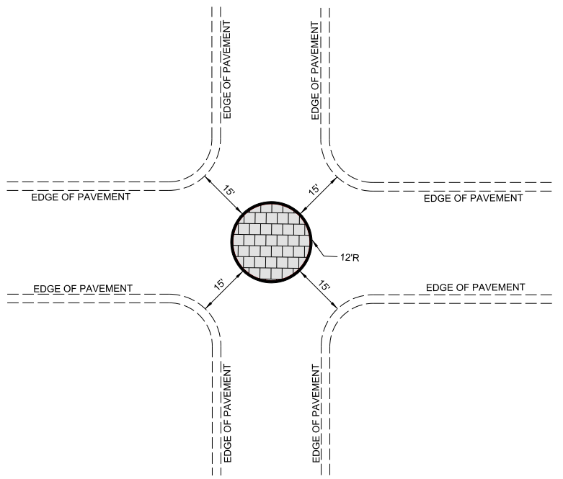
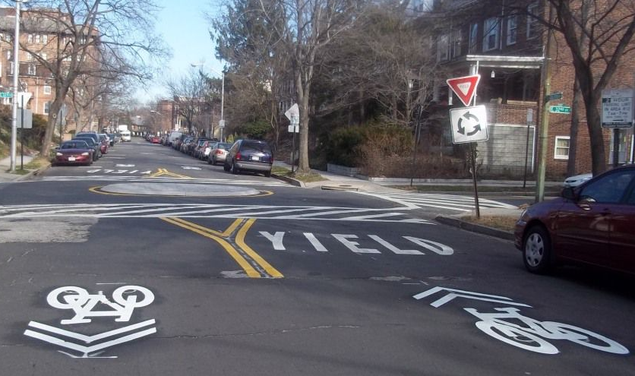
Neighborhood Traffic Circle (horizontal)
*Neighborhood Traffic Circle to be placed within existing curb lines – no impacts outside of existing roadway

Slide 8
Neighborhood Traffic Circle (horizontal)
Pros
Cons
Helps decrease speed of vehicles as they enter/drive through the intersection
Helps to reduce the frequency and severity of collisions
Increases safety for pedestrians and cyclists at the intersection
Minimal impact to emergency service’s response times
Not all intersections meet the minimum dimensions for installation
Slightly longer installation time, typical for treatments made of concrete

Slide 9
Design Comments from the Neighborhood
Requested an additional speed hump on the north end of the project.
Staff evaluated and deemed the additional speed hump appropriate. A slight shifting of speed humps from their original locations was needed to maintain approximately equal spacing.
There were concerns and approvals surrounding the neighborhood traffic circle.
At this point, staff is still recommending a neighborhood traffic circle in this location as it is an appropriate and effective tool for this area. Please discuss this in greater detail in the comment portal.

Slide 10
Public Comment
Based on this updated design, what comments do you still have?
Have we adequately addressed problem areas you see?
What other questions, comments, suggestions do you have?

Slide 11
Next Steps
Once the public comment period for the Final Design ends, the neighborhood will be sent a Final Ballot asking if you want the project constructed. Ballot approval thresholds will be the same as the First Ballot.
On-street
Participation Minimum: 50%
Approval Rating Minimum: 70%
Neighborhood
Participation Minimum: 25%
Approval Rating Minimum: 60%

Slide 12
Please direct all comments and questions to staff using the PublicInput portal for Mapleridge Rd. Staff will respond and we can have a neighborhood wide conversation.

