Slide 1
TRANSPORTATION
Preliminary Traffic Calming Design & Public Comment

Slide 2
Project Goal
The project will be deemed effective if 85% of drivers are going at or below the 25 mph speed limit and top driver speed is capped at around 5-7 mph over the speed limit
Based on your location, Glascock St, Edmund St, and N King Charles Rd are the closest completed traffic calming project to you. We encourage you to drive these streets for yourself to experience the final project.
Once the project has been completed for approximately 6 months, an after-study will be performed to measure project effectiveness

Slide 3
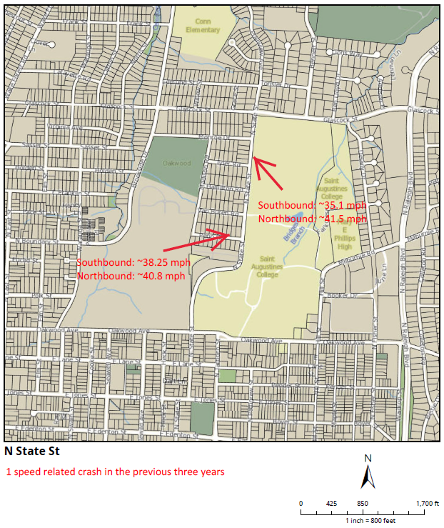
Evaluation Data

Slide 4
Treatment Selection and Spacing
Based on the characteristics of N State St and the Long-Term Bikeway Plan showing bike lanes, speed humps have been deemed the most appropriate traffic calming treatment.
The speed humps have been placed at approximately 500’ – 600’ spacing to achieve the project goal.

Slide 5
Speed Humps (vertical)

Slide 6
Speed Humps (vertical)
Pros
Cons
Can be the most effective
Fast installation time/Less impact during construction
Versatile placement options based on compact footprint
Does not contrast as much with existing roadway
Impact to driving comfort
Creates slight delay in emergency service’s response times

Slide 7
Design Comments from the Neighborhood
Based on observations felt that a speed hump was a better use of funds and treatment as opposed to the raised crosswalk.
Staff evaluated and agreed that a speed hump would be a viable alternate choice in this location. The proximity to the curb ramps will still increase pedestrians crossing in this location, while also being a better treatment for any future bike lane retrofits.

Slide 8
Public Comment
Based on this updated design, what comments do you still have?
Have we adequately addressed problem areas you see?
What other questions, comments, suggestions do you have?

Slide 9
Next Steps
Once the public comment period for the Final Design ends, the neighborhood will be sent a Final Ballot asking if you want the project constructed. Ballot approval thresholds will be the same as the First Ballot.
On-street
Participation Minimum: 50%
Approval Rating Minimum: 70%
Neighborhood
Participation Minimum: 25%
Approval Rating Minimum: 60%

Slide 10
Please direct all comments and questions to staff using the PublicInput portal for N State St. Staff will respond and we can have a neighborhood wide conversation.

