Slide 1
TRANSPORTATION
Preliminary Traffic Calming Design & Public Comment

Slide 2
How do we approach the traffic calming design?
Consistent treatment placement along entire street
400’ – 700’ spacing of treatments
Close spacing is used for streets with a higher speed compliance issue
Target pedestrian heavy amenities to increase safety, such the Crabtree Creek greenway trail and existing bike lanes
Targeted placement to fix a speed related crash issue
If a pattern of speed related crashes is identified, targeted treatment placement can eliminate that crash pattern
If no pattern is identified locationally, but multiple speed related crashes have occurred, consistent treatment spacing can help eliminate crashes along an entire street

Slide 3
Treatment Limitations
Your street’s width will determine what types of treatments can be placed
Milburnie Rd is approximately 41’ wide
Based on this street width, lack of intersections, and existing bike infrastructure, vertical traffic calming elements are appropriate and are being proposed as part of this project
Due to the 30-mph speed limit and relatively high vehicular volumes, speed tables are the most appropriate vertical traffic calming device

Slide 4
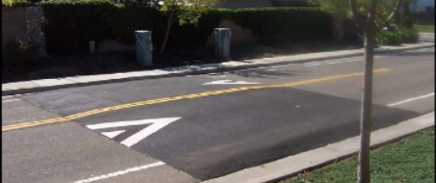
Speed Table (vertical)

Slide 5
Speed Table (vertical)
Pros
Cons
Can be the most effective
Fast installation time/Less impact during construction
Versatile placement options based on compact footprint
Does not contrast as much with existing roadway
Impact to driving comfort
Creates slight delay in emergency service’s response times

Slide 6
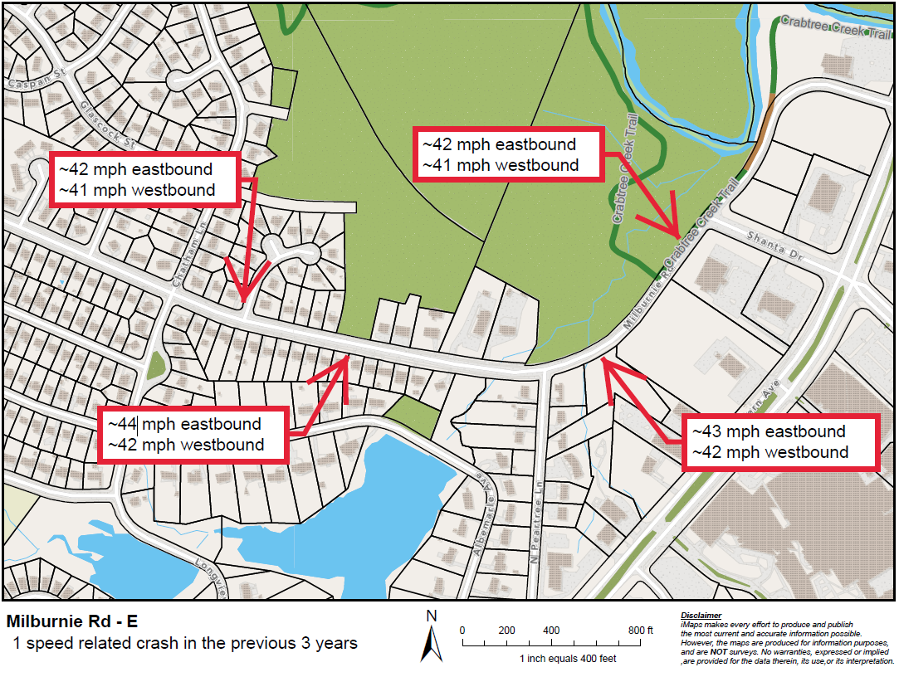
Evaluation Data

Slide 7
Design Process
Based on the speed progression and high vehicular volumes along Milburnie Rd, we are proposing treatment spacing of approximately 500’ – 600’ intervals
A speed related crash issue was not identified through our evaluation. The focus of this project is speed reduction

Slide 8
Project Goal
The project will be deemed effective if 85% of drivers are going at or below the 30 mph speed limit and top driver speed is capped at around 5-7 mph over the speed limit
Based on your location, King Charles Rd, Milburnie Rd – W, and Glascock St are the closest completed traffic calming project to you with this style of completed project. We encourage you to go drive these streets yourself to experience the final project.
Once the project has been completed for approximately 6 months, an after-study will be performed to measure project effectiveness

Slide 9
Public Comment
What are your thoughts on the proposed design?
Should we place more or less treatments along the street?
Have we adequately addressed problem areas you see?
Should we place another traffic calming treatment in a targeted location?
What other questions, comments, suggestions do you have?

Slide 10
Please direct all comments and questions to staff using the PublicInput portal for Milburnie Rd - E. Staff will respond and we can have a neighborhood wide conversation.

