Slide 1
TRANSPORTATION
Final Traffic Calming Design & Public Comment

Slide 2
Project Goal
The project will be deemed effective if 85% of drivers are going at or below the 25 mph speed limit and top driver speed is capped at around 5-7 mph over the speed limit
Based on your location, Shelley Rd, Cranbrook Rd, and Northbrook Drare the closest completed traffic calming project to you with this style of completed project. We encourage you to go drive these streets yourself to experience the final project.
Once the project has been completed for approximately 6 months, an after-study will be performed to measure project effectiveness

Slide 3
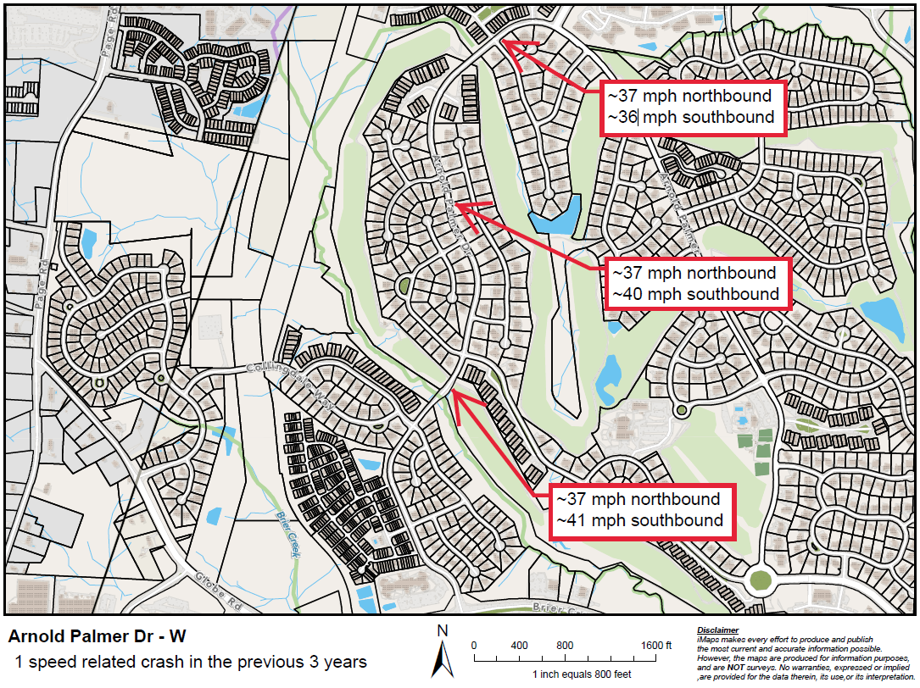
Evaluation Data

Slide 4
Speed Humps (vertical)

Slide 5
Speed Humps (vertical)
Pros
Cons
Can be the most effective
Fast installation time/Less impact during construction
Versatile placement options based on compact footprint
Does not contrast as much with existing roadway
Impact to driving comfort
Creates slight delay in emergency service’s response times

Slide 6
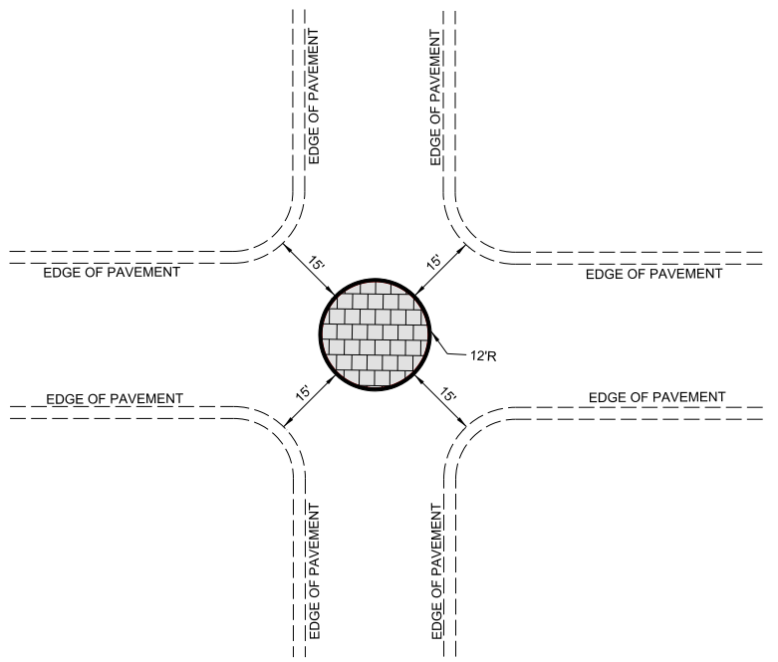
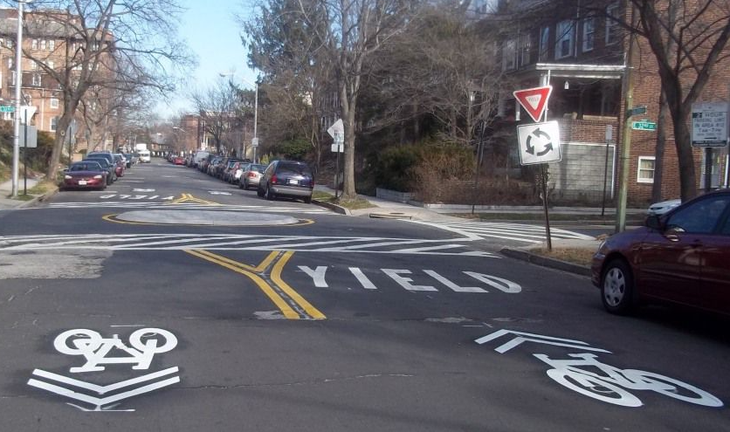
Neighborhood Traffic Circle (horizontal)
*Neighborhood Traffic Circle to be placed within existing curb lines – no impacts outside of existing roadway

Slide 7
Neighborhood Traffic Circle (horizontal)
Pros
Cons
Helps decrease speed of vehicles as they enter/drive through the intersection
Helps to reduce the frequency and severity of collisions
Increases safety for pedestrians and cyclists at the intersection
Minimal impact to emergency service’s response times
Not all intersections meet the minimum dimensions for installation
Slightly longer installation time, typical for treatments made of concrete

Slide 8
Design Comments from the Neighborhood
Many neighbors brought up the intersection of Arnold Palmer Dr and Club Valley Way as a major pedestrian crossing
Staff evaluated this intersection based on these comments and we’re proposing the addition of a neighborhood traffic circle to slow drivers down through this intersection and increase pedestrian safety

Slide 9
Design Comments from the Neighborhood
Some neighbors expressed their concern with the total number of treatments and asked us to verify spacing
Staff re-evaluated the spacing and is not recommending a reduction in the total number being proposed. We did replace one neighborhood traffic circle with a speed hump and shifted its placement. The remainder of the project is focused on improving safety for golf path crossings, increasing safety around identified high pedestrian crossings, and then spacing treatments using that best practice spacing along the remainder of the street

Slide 10
Public Comment
Based on this updated design, what comments do you still have?
Have we adequately addressed problem areas you see?
What other questions, comments, suggestions do you have?

Slide 11
Next Steps
Once the public comment period for the Final Design ends, the neighborhood will be sent a Final Ballot asking if you want the project constructed. Ballot approval thresholds are shown below:
On-street
Approval Rating Minimum: 70%
Neighborhood
Approval Rating Minimum: 60%

Slide 12
Please direct all comments and questions to staff using the PublicInput portal for Arnold Palmer Dr - W. Staff will respond and we can have a neighborhood wide conversation.

