Slide 1
TRANSPORTATION
Final Traffic Calming Design & Public Comment

Slide 2
Project Goal
The project will be deemed effective if 85% of drivers are going at or below the 25 mph speed limit and top driver speed is capped at around 5-7 mph over the speed limit
Based on your location, Lake Boone Trl, Van Dyke Ave, and Woodburn Rd are the closest completed traffic calming project to you with this style of completed project. We encourage you to go drive these streets yourself to experience the final project.
Once the project has been completed for approximately 6 months, an after-study will be performed to measure project effectiveness

Slide 3
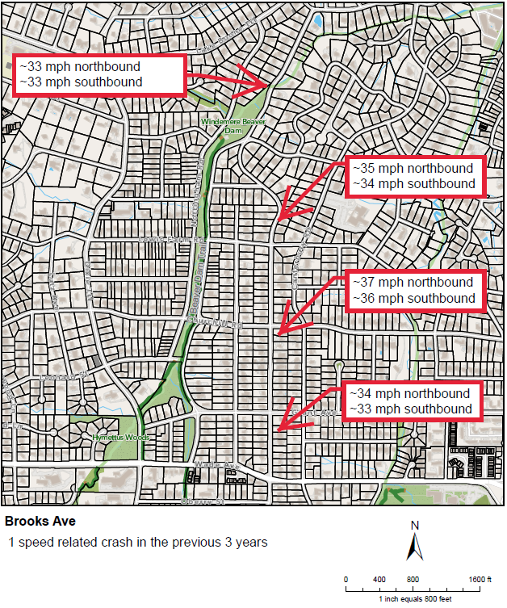
Evaluation Data

Slide 4
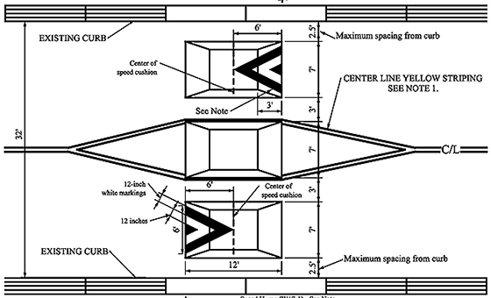
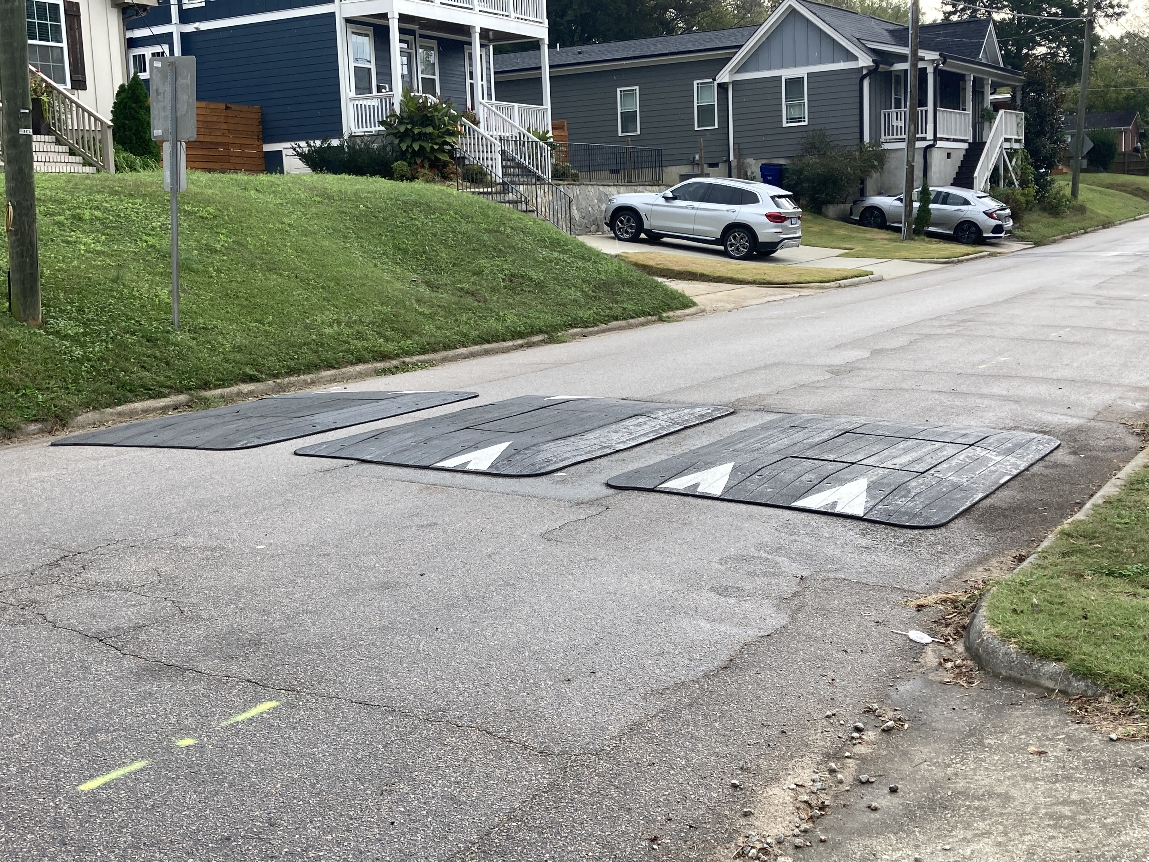
Speed Cushions (vertical)
*Speed Cushion dimensions vary based on roadway dimensions

Slide 5
Speed Cushions (vertical)
Pros
Cons
Can be as effective as speed humps
Relatively low impact installation timeline, but slightly slower than a standard hump as more labor is required
Versatile placement options based on compact footprint
Slightly faster emergency service’s response times due to tire slits for larger vehicles
Does not contrast as much with existing roadway
Reduced driving comfort
There is still some level of delay to emergency service’s response times when compared with no treatment

Slide 6
Design Comments from the Neighborhood
The neighborhood expressed concerns about speed cushion spacing
Staff re-evaluated the placement and identified that placing treatments approximately between the existing stop signs and at approximately 400’-600’ spacing for the rest of the street provides the best opportunity for a successful traffic calming project

Slide 7
Design Comments from the Neighborhood
The neighborhood expressed concerns about proximity of speed cushions to driveways
Staff has evaluated and will ensure that all minimum spacing practices are being adhered to

Slide 8
Design Comments from the Neighborhood
The neighborhood expressed concerns about traffic calming project impacts on home values
Staff has evaluated this and has found no correlation.
Ultimately this is your choice as a neighborhood to determine if you feel a traffic calming project adds value to your street or if you feel a traffic calming project detracts value to your street and you would prefer conditions to stay the same. The Final Ballot will be your opportunity to officially express this opinion and make your voice heard

Slide 9
Public Comment
Based on this updated design, what comments do you still have?
Have we adequately addressed problem areas you see?
What other questions, comments, suggestions do you have?

Slide 10
Next Steps
Once the public comment period for the Final Design ends, the neighborhood will be sent a Final Ballot asking if you want the project constructed. Ballot approval thresholds are shown below:
On-street
Approval Rating Minimum: 70%
Neighborhood
Approval Rating Minimum: 60%

Slide 11
Please direct all comments and questions to staff using the PublicInput portal for Brooks Ave. Staff will respond and we can have a neighborhood wide conversation.

