Slide 1
TRANSPORTATION
Final Traffic Calming Design & Public Comment

Slide 2
Project Goal
The project will be deemed effective if 85% of drivers are going at or below the 25 mph speed limit and top driver speed is capped at around 5-7 mph over the speed limit
Based on your location, Pineview Dr, Merrie Rd, and Marcom St are the closest completed traffic calming project to you with this style of completed project. We encourage you to go drive these streets yourself to experience the final project.
Once the project has been completed for approximately 6 months, an after-study will be performed to measure project effectiveness

Slide 3
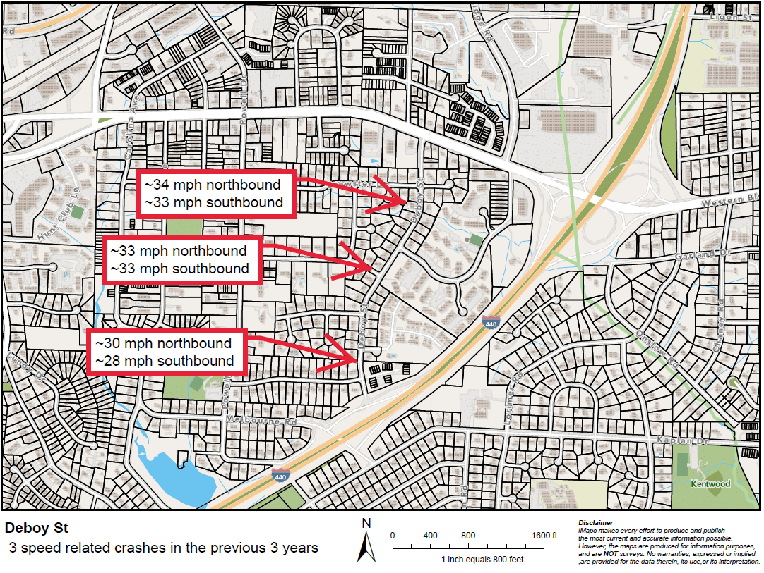
Evaluation Data

Slide 4
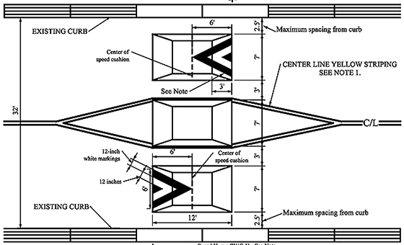
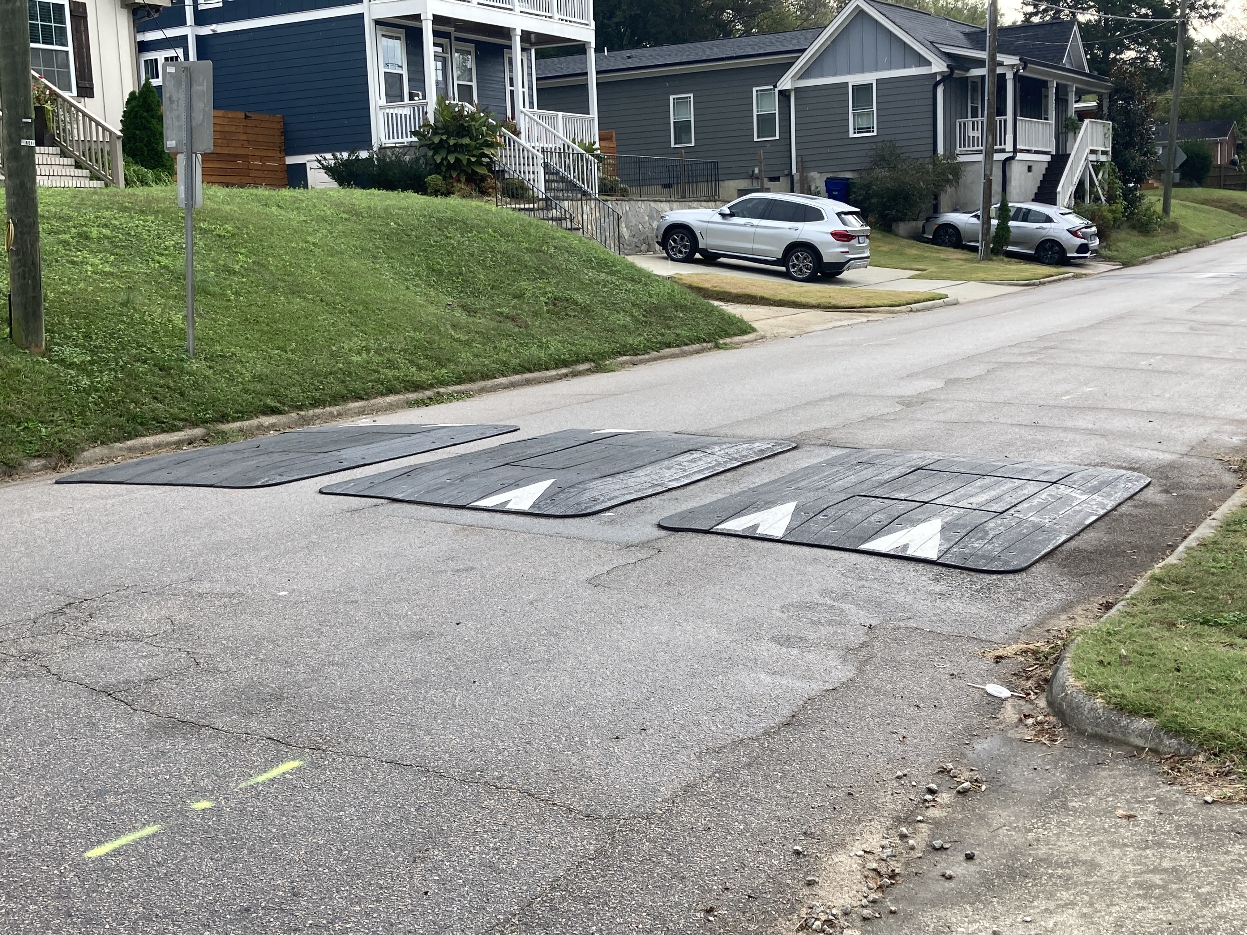
Speed Cushions (vertical)
*Speed Cushion dimensions vary based on roadway dimensions

Slide 5
Speed Cushions (vertical)
Pros
Cons
Can be as effective as speed humps
Relatively low impact installation timeline, but slightly slower than a standard hump as more labor is required
Versatile placement options based on compact footprint
Slightly faster emergency service’s response times due to tire slits for larger vehicles
Does not contrast as much with existing roadway
Reduced driving comfort
There is still some level of delay to emergency service’s response times when compared with no treatment

Slide 6
Design Comments from the Neighborhood
A neighbor made a comment that they were concerned about emergency response times
Staff is recommending speed cushions as a response to this concern. All traffic calming projects have an impact on emergency response times, but it has been found that speed cushions typically have less than a 1 second impact on response times

Slide 7
Design Comments from the Neighborhood
A neighbor voiced their concern with the previously proposed neighborhood traffic circle and access to their property
Based on this concern, staff has replaced the neighborhood traffic circle with a speed cushion in the same general location

Slide 8
Public Comment
Based on this updated design, what comments do you still have?
Have we adequately addressed problem areas you see?
What other questions, comments, suggestions do you have?

Slide 9
Next Steps
Once the public comment period for the Final Design ends, the neighborhood will be sent a Final Ballot asking if you want the project constructed. Ballot approval thresholds are shown below:
On-street
Approval Rating Minimum: 70%
Neighborhood
Approval Rating Minimum: 60%

Slide 10
Please direct all comments and questions to staff using the PublicInput portal for Deboy St. Staff will respond and we can have a neighborhood wide conversation.

