Slide 1
TRANSPORTATION
Final Traffic Calming Design & Public Comment

Slide 2
Project Goal
The project will be deemed effective if 85% of drivers are going at or below the 25 mph speed limit and top driver speed is capped at around 5-7 mph over the speed limit
Based on your location, Oakwood Ave, N King Charles Rd, Glascock St and Bennett St are the closest completed traffic calming project to you with this style of completed project. We encourage you to go drive these streets yourself to experience the final project.
Once the project has been completed for approximately 6 months, an after-study will be performed to measure project effectiveness

Slide 3
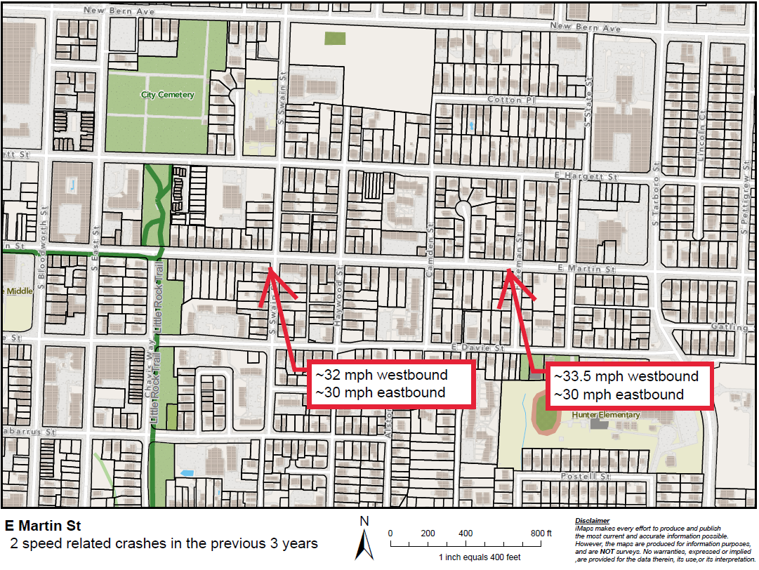
Evaluation Data

Slide 4
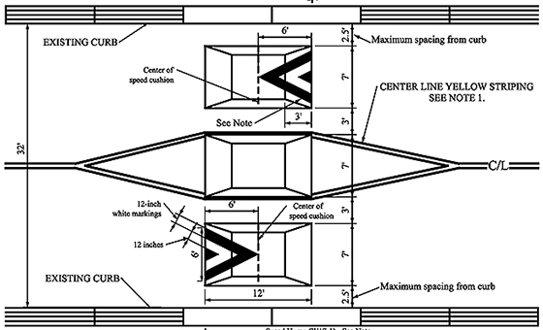
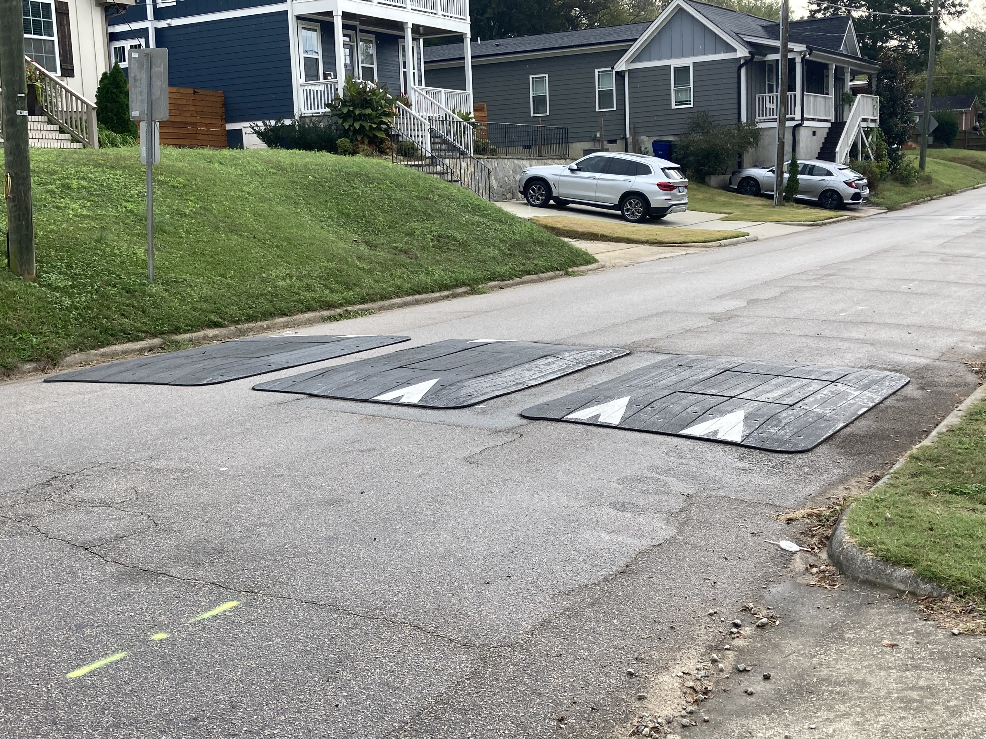
Speed Cushions (vertical)
*Speed Cushion dimensions vary based on roadway dimensions

Slide 5
Speed Cushions (vertical)
Pros
Cons
Can be as effective as speed humps
Relatively low impact installation timeline, but slightly slower than a standard hump as more labor is required
Versatile placement options based on compact footprint
Slightly faster emergency service’s response times due to tire slits for larger vehicles
Does not contrast as much with existing roadway
Reduced driving comfort
There is still some level of delay to emergency service’s response times when compared with no treatment

Slide 6
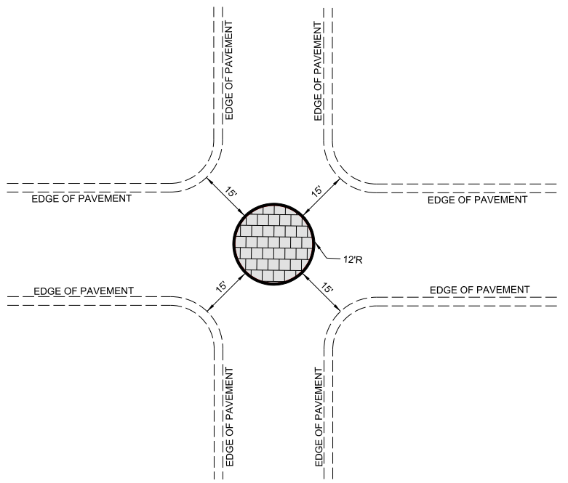
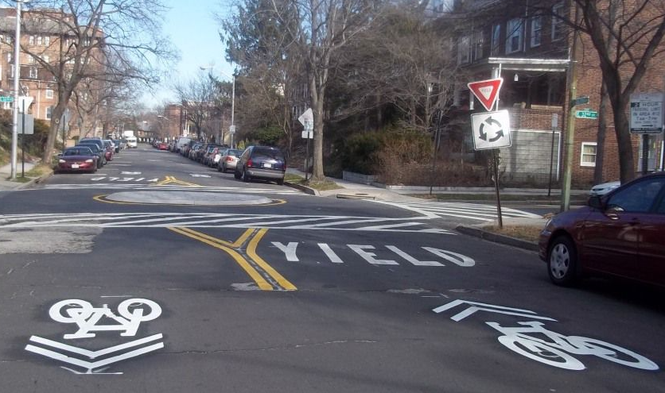
Neighborhood Traffic Circle (horizontal)
*Neighborhood Traffic Circle to be placed within existing curb lines – no impacts outside of existing roadway

Slide 7
Neighborhood Traffic Circle (horizontal)
Pros
Cons
Helps decrease speed of vehicles as they enter/drive through the intersection
Helps to reduce the frequency and severity of collisions
Increases safety for pedestrians and cyclists at the intersection
Minimal impact to emergency service’s response times
Not all intersections meet the minimum dimensions for installation
Slightly longer installation time, typical for treatments made of concrete

Slide 8
Design Comments from the Neighborhood
A majority of comments voiced their support for the neighborhood traffic circles, but at least one neighbor asked we evaluate more speed humps and less traffic circles
Staff evaluated the proposed mix of traffic calming treatments and is recommending the treatment mix remains as shown. With the narrow lots and seemingly random driveways, physically fitting speed humps along the street is difficult. Neighborhood traffic circles eliminate the conflict with driveways, work well at slowing drivers down, and increase intersection safety

Slide 9
Public Comment
Based on this updated design, what comments do you still have?
Have we adequately addressed problem areas you see?
What other questions, comments, suggestions do you have?

Slide 10
Next Steps
Once the public comment period for the Final Design ends, the neighborhood will be sent a Final Ballot asking if you want the project constructed. Ballot approval thresholds are shown below:
On-street
Approval Rating Minimum: 70%
Neighborhood
Approval Rating Minimum: 60%

Slide 11
Please direct all comments and questions to staff using the PublicInput portal for E Martin St. Staff will respond and we can have a neighborhood wide conversation.

