Slide 1
TRANSPORTATION
Final Traffic Calming Design & Public Comment

Slide 2
Project Goal
The project will be deemed effective if 85% of drivers are going at or below the 25 mph speed limit and top driver speed is capped at around 5-7 mph over the speed limit
Based on your location, Pineview Dr, Merrie Rd, and Marcom St are the closest completed traffic calming project to you with this style of completed project. We encourage you to go drive these streets yourself to experience the final project.
Once the project has been completed for approximately 6 months, an after-study will be performed to measure project effectiveness

Slide 3
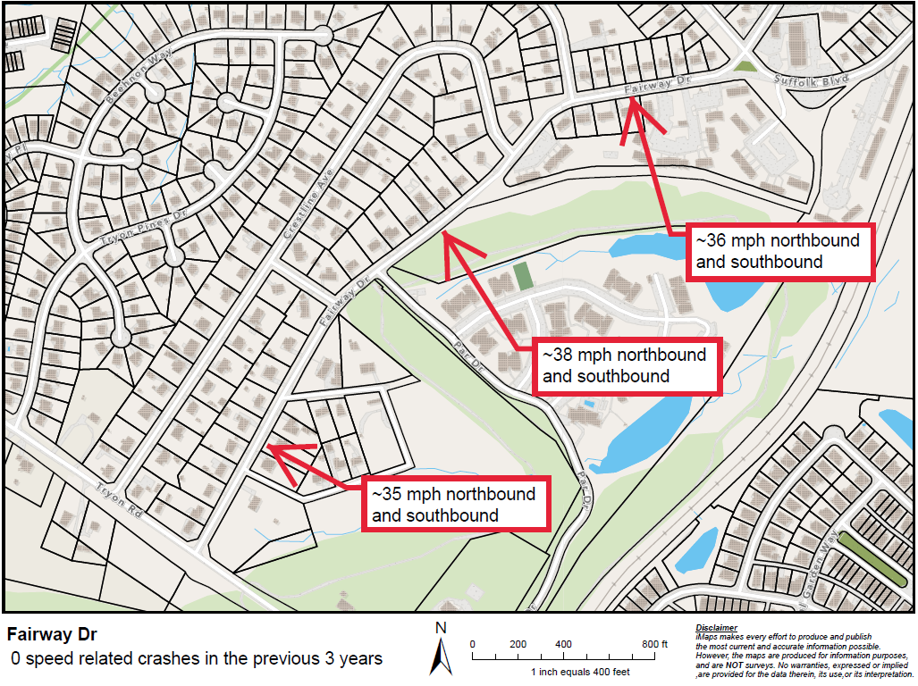
Evaluation Data

Slide 4
Speed Humps (vertical)

Slide 5
Speed Humps (vertical)
Pros
Cons
Can be the most effective
Fast installation time/Less impact during construction
Versatile placement options based on compact footprint
Does not contrast as much with existing roadway
Impact to driving comfort
Creates slight delay in emergency service’s response times

Slide 6
Design Comments from the Neighborhood
The neighborhood requested something near Par St
Staff has ensured a speed hump is placed directly adjacent to Par St, just south of the intersection
The neighborhood requested fewer speed humps
Staff re-evaluated the total number and was able to shift speed hump locations around so that best practice spacing is maintained and so that one of the originally proposed speed humps could be removed

Slide 7
Public Comment
Based on this updated design, what comments do you still have?
Have we adequately addressed problem areas you see?
What other questions, comments, suggestions do you have?

Slide 8
Next Steps
Once the public comment period for the Final Design ends, the neighborhood will be sent a Final Ballot asking if you want the project constructed. Ballot approval thresholds are shown below:
On-street
Approval Rating Minimum: 70%
Neighborhood
Approval Rating Minimum: 60%

Slide 9
Please direct all comments and questions to staff using the PublicInput portal for Fairway Dr. Staff will respond and we can have a neighborhood wide conversation.

