Slide 1
TRANSPORTATION
Final Traffic Calming Design & Public Comment

Slide 2
Project Goal
The project will be deemed effective if 85% of drivers are going at or below the 25 mph speed limit and top driver speed is capped at around 5-7 mph over the speed limit
Based on your location, Shelley Rd, Cranbrook Rd, and Northbrook Dr are the closest completed traffic calming project to you with this style of completed project. We encourage you to go drive these streets yourself to experience the final project.
Once the project has been completed for approximately 6 months, an after-study will be performed to measure project effectiveness

Slide 3
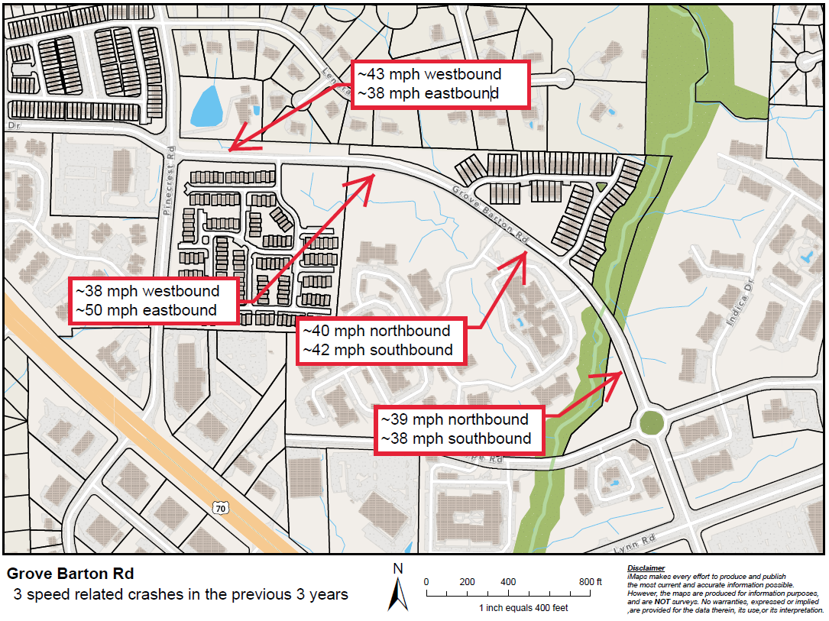
Evaluation Data

Slide 4
Speed Humps (vertical)

Slide 5
Speed Humps (vertical)
Pros
Cons
Can be the most effective
Fast installation time/Less impact during construction
Versatile placement options based on compact footprint
Does not contrast as much with existing roadway
Impact to driving comfort
Creates slight delay in emergency service’s response times

Slide 6
Design Comments from the Neighborhood
Request to add cycling infrastructure
Staff was able to evaluate and is proposing a two-way cycle track on the north side of Grove Barton Rd. This will provide cyclists with dedicated space as well as narrow the roadway footprint to enhance the traffic calming project’s effectiveness

Slide 7
Design Comments from the Neighborhood
Request to restrict On-street parking
Staff was able to evaluate the conditions and does not recommend widespread parking restrictions along the south side of Grove Barton Rd. We are evaluating targeted restrictions based on existing street intersections. Any recommendations from the Parking Division will be implemented outside of the traffic calming project process. The addition of the bicycle infrastructure will restrict all on-street parking on the north side of the street.

Slide 8
Design Comments from the Neighborhood
Request to add crosswalks
Staff is evaluating existing pedestrian usage to determine locational need. Typically, with projects we know this is going to change driver behavior and that impacts all other roadway users. We like to implement this change, see how pedestrians change their habits and then mark crosswalks in locations where we know they will be used. This effort and evaluation is ongoing

Slide 9
Public Comment
Based on this updated design, what comments do you still have?
Have we adequately addressed problem areas you see?
What other questions, comments, suggestions do you have?

Slide 10
Next Steps
Once the public comment period for the Final Design ends, the neighborhood will be sent a Final Ballot asking if you want the project constructed. Ballot approval thresholds are shown below:
On-street
Approval Rating Minimum: 70%
Neighborhood
Approval Rating Minimum: 60%

Slide 11
Please direct all comments and questions to staff using the PublicInput portal for Grove Barton Rd. Staff will respond and we can have a neighborhood wide conversation.

