Slide 1
TRANSPORTATION
Final Traffic Calming Design & Public Comment

Slide 2
Project Goal
The project will be deemed effective if 85% of drivers are going at or below the 30 mph speed limit and top driver speed is capped at around 5-7 mph over the speed limit
Based on your location, Wimbleton Dr, Shelley Rd, and Cranbrook Rd are the closest completed traffic calming project to you with this style of completed project. We encourage you to go drive these streets yourself to experience the final project.
Once the project has been completed for approximately 6 months, an after-study will be performed to measure project effectiveness

Slide 3
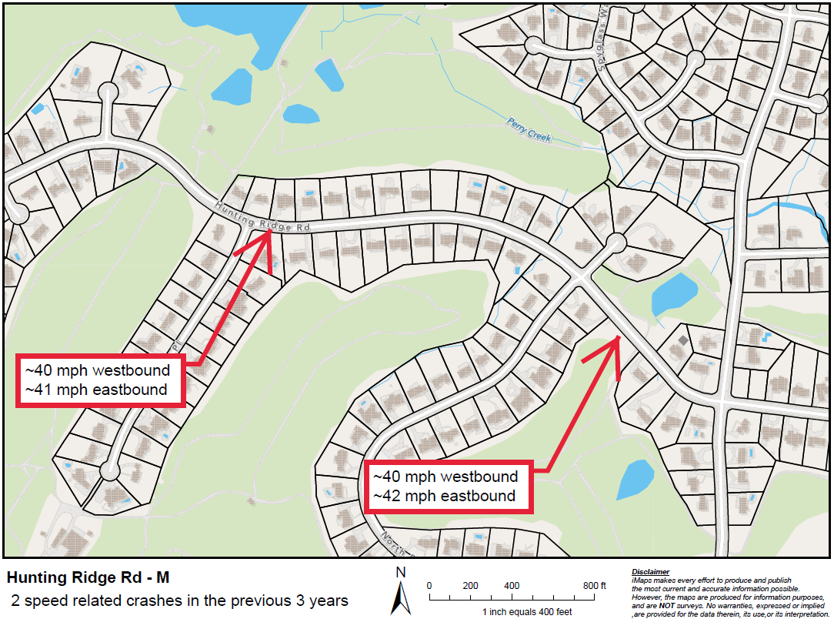
Evaluation Data

Slide 4
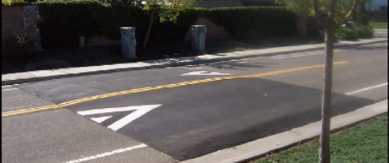
Speed Table (vertical)

Slide 5
Speed Table (vertical)
Pros
Cons
Can be the most effective
Fast installation time/Less impact during construction
Versatile placement options based on compact footprint
Does not contrast as much with existing roadway
Impact to driving comfort
Creates slight delay in emergency service’s response times

Slide 6
Design Comments from the Neighborhood
Neighbors expressed their concerns for intersection safety at the intersection of Hunting Ridge Rd at North Ridge Dr
Staff evaluated this intersection for an all-way stop conversion and warrants per the Manual for Uniform Traffic Control Devices (MUTCD) were met. It was determined intersection safety would be increased with this addition due to the lack of sight lines. This approval is outside of the traffic calming project process but will be implemented in conjunction with this project and incorporated into the overall design

Slide 7
Design Comments from the Neighborhood
Neighbors requested we look at existing golf path crossings for treatment placement
Staff evaluated the existing golf path crossings and worked to place treatments as close as possible. Due to the hills and curves of Hunting Ridge Rd, placement was limited. Speed tables are placed as close to golf path crossings as placement rules allow

Slide 8
Design Comments from the Neighborhood
A neighbor requested we look to increase pedestrian safety and crossings
Staff looked into this and with the recommended all-way stop conversion at North Ridge Dr, the existing all-way stop at Rainwater Rd, and the consistently placed speed tables, as drivers slow down, pedestrian safety will increase

Slide 9
Public Comment
Based on this updated design, what comments do you still have?
Have we adequately addressed problem areas you see?
What other questions, comments, suggestions do you have?

Slide 10
Next Steps
Once the public comment period for the Final Design ends, the neighborhood will be sent a Final Ballot asking if you want the project constructed. Ballot approval thresholds are shown below:
On-street
Approval Rating Minimum: 70%
Neighborhood
Approval Rating Minimum: 60%

Slide 11
Please direct all comments and questions to staff using the PublicInput portal for Hunting Ridge Rd - M. Staff will respond and we can have a neighborhood wide conversation.

