Slide 1
TRANSPORTATION
Final Traffic Calming Design & Public Comment

Slide 2
Project Goal
The project will be deemed effective if 85% of drivers are going at or below the 25 mph speed limit and top driver speed is capped at around 5-7 mph over the speed limit
Based on your location, Clarks Fork Dr, Neuse Crossing Dr, and Carlton Dr are the closest completed traffic calming project to you with this style of completed project. We encourage you to go drive these streets yourself to experience the final project.
Once the project has been completed for approximately 6 months, an after-study will be performed to measure project effectiveness

Slide 3
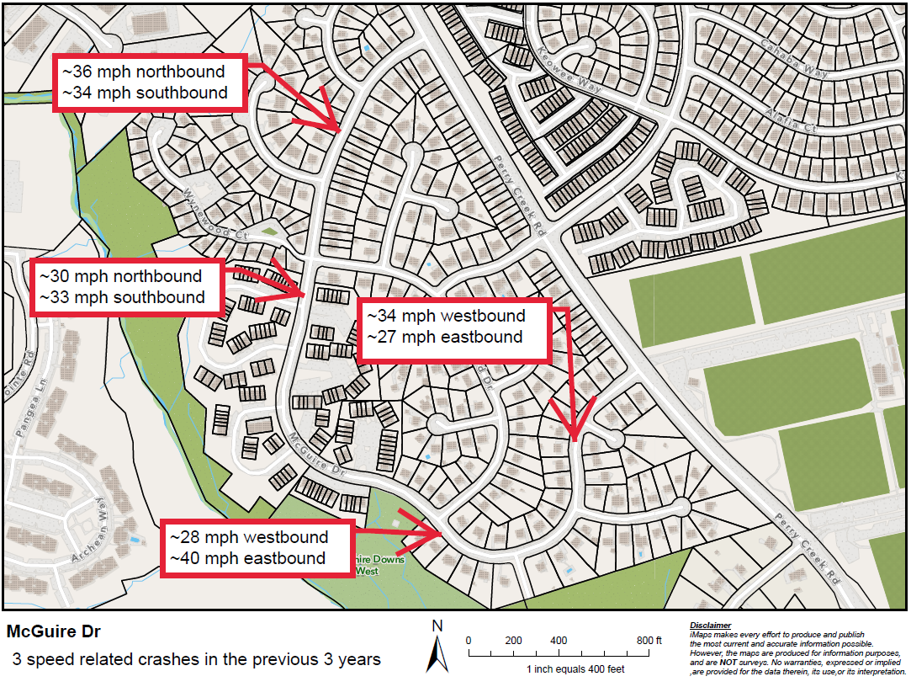
Evaluation Data

Slide 4
Speed Humps (vertical)

Slide 5
Speed Humps (vertical)
Pros
Cons
Can be the most effective
Fast installation time/Less impact during construction
Versatile placement options based on compact footprint
Does not contrast as much with existing roadway
Impact to driving comfort
Creates slight delay in emergency service’s response times

Slide 6
Design Comments from the Neighborhood
Some neighbors were concerned about emergency response times
This is something we weigh and work to balance the design. Speed humps typically slow down emergency response times around 5-7 seconds per location. But they work 24/7 to reduce speeding drivers to make your street safer. This project is a neighborhood choice to determine if the pros of the project outweigh the cons. The Final Ballot will be your way to make you opinions heard as a neighborhood

Slide 7
Public Comment
Based on this updated design, what comments do you still have?
Have we adequately addressed problem areas you see?
What other questions, comments, suggestions do you have?

Slide 8
Next Steps
Once the public comment period for the Final Design ends, the neighborhood will be sent a Final Ballot asking if you want the project constructed. Ballot approval thresholds are shown below:
On-street
Approval Rating Minimum: 70%
Neighborhood
Approval Rating Minimum: 60%

Slide 9
Please direct all comments and questions to staff using the PublicInput portal for McGuire Dr. Staff will respond and we can have a neighborhood wide conversation.

