Slide 1
TRANSPORTATION
Final Traffic Calming Design & Public Comment

Slide 2
Project Goal
The project will be deemed effective if 85% of drivers are going at or below the 30 mph speed limit and top driver speed is capped at around 5-7 mph over the speed limit
Based on your location, King Charles Rd, Milburnie Rd – W, and Glascock St are the closest completed traffic calming project to you with this style of completed project. We encourage you to go drive these streets yourself to experience the final project.
Once the project has been completed for approximately 6 months, an after-study will be performed to measure project effectiveness

Slide 3
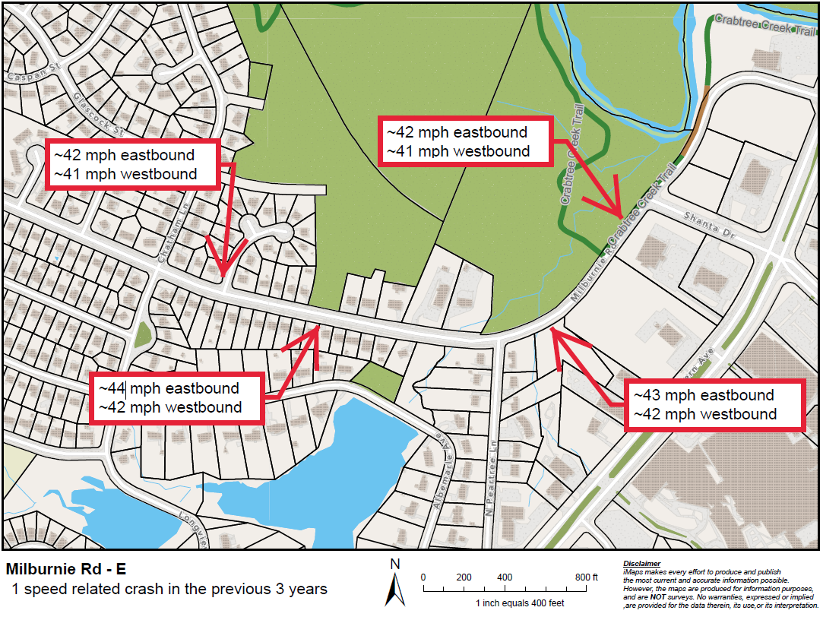
Evaluation Data

Slide 4
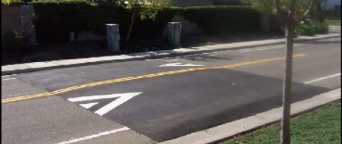
Speed Table (vertical)

Slide 5
Speed Table (vertical)
Pros
Cons
Can be the most effective
Fast installation time/Less impact during construction
Versatile placement options based on compact footprint
Does not contrast as much with existing roadway
Impact to driving comfort
Creates slight delay in emergency service’s response times

Slide 6
Design Comments from the Neighborhood
Neighbors asked about how speed tables will impact the existing bike lanes
The design of these speed table will stop at the bike lane transition and not extend the full road width and only focus on the vehicular travel lane. Vertical delineators will be placed on each side of the speed table to keep drivers from driving around them and into the bike lane. This was done along Oakwood Ave if you would like to see how this will look in a real life setting.

Slide 7
Public Comment
Based on this updated design, what comments do you still have?
Have we adequately addressed problem areas you see?
What other questions, comments, suggestions do you have?

Slide 8
Next Steps
Once the public comment period for the Final Design ends, the neighborhood will be sent a Final Ballot asking if you want the project constructed. Ballot approval thresholds are shown below:
On-street
Approval Rating Minimum: 70%
Neighborhood
Approval Rating Minimum: 60%

Slide 9
Please direct all comments and questions to staff using the PublicInput portal for Milburnie Rd - E. Staff will respond and we can have a neighborhood wide conversation.

