Slide 1
TRANSPORTATION
Final Traffic Calming Design & Public Comment

Slide 2
Project Goal
The project will be deemed effective if 85% of drivers are going at or below the 25 mph speed limit and top driver speed is capped at around 5-7 mph over the speed limit
Based on your location, Baugh St and Huntleigh Dr are the closest completed traffic calming project to you with this style of completed project. We encourage you to go drive these streets yourself to experience the final project.
Once the project has been completed for approximately 6 months, an after-study will be performed to measure project effectiveness

Slide 3
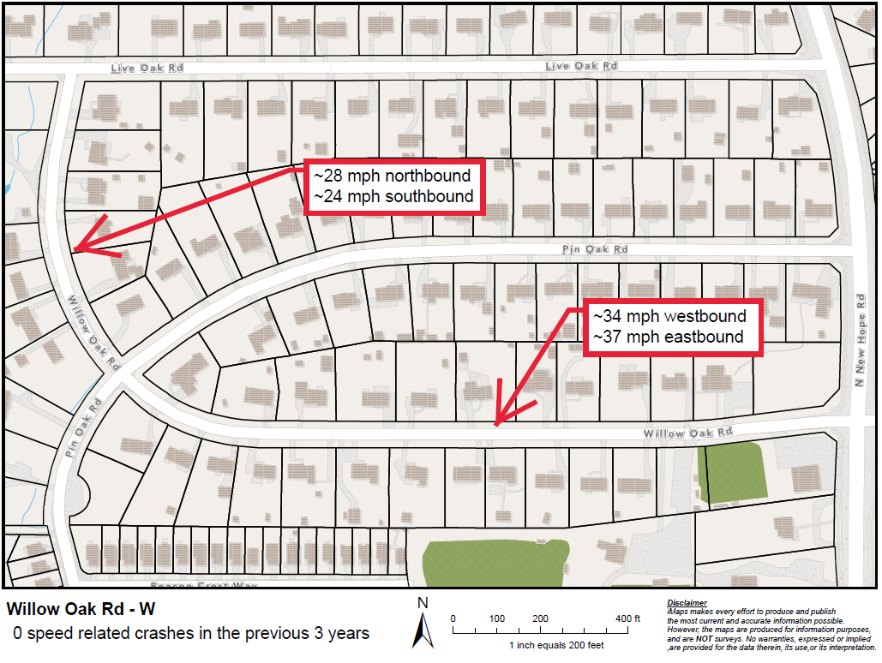
Evaluation Data

Slide 4
Speed Humps (vertical)

Slide 5
Speed Humps (vertical)
Pros
Cons
Can be the most effective
Fast installation time/Less impact during construction
Versatile placement options based on compact footprint
Does not contrast as much with existing roadway
Impact to driving comfort
Creates slight delay in emergency service’s response times

Slide 6
Design Comments from the Neighborhood
A neighbor was concerned about the location of a speed hump being close to the driveway at 4016 Willow Oak Rd
Staff evaluated this location and we were able to shift it to the west a little further from the driveway

Slide 7
Design Comments from the Neighborhood
Intersection safety at Willow Oak Rd and Pin Oak Rd
After further evaluation, staff has determined that a neighborhood traffic circle is not appropriate at this intersection. We are actively looking at alternative intersection safety improvements, such as an all-way stop, that can be incorporated into the larger traffic calming project effort

Slide 8
Public Comment
Based on this updated design, what comments do you still have?
Have we adequately addressed problem areas you see?
What other questions, comments, suggestions do you have?

Slide 9
Next Steps
Once the public comment period for the Final Design ends, the neighborhood will be sent a Final Ballot asking if you want the project constructed. Ballot approval thresholds are shown below:
On-street
Approval Rating Minimum: 70%
Neighborhood
Approval Rating Minimum: 60%

Slide 10
Please direct all comments and questions to staff using the PublicInput portal for Willow Oak Rd - W. Staff will respond and we can have a neighborhood wide conversation.

